Slide 1
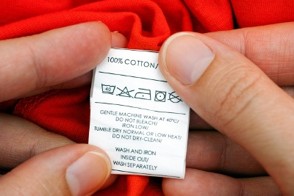
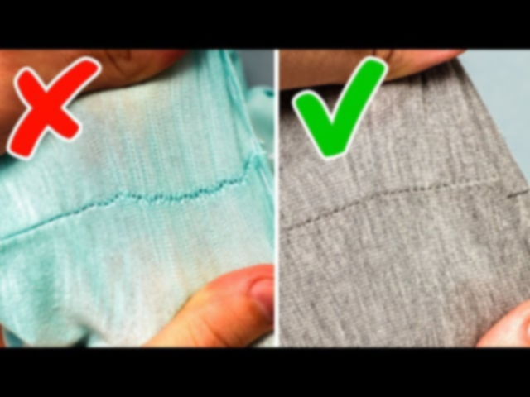
Automatic Categorization of quality Clothing Using Machine learning
Guide :
Dr.S.Sivasubramanian
Presented by :
Jyothika K 410717104036
Pavithra R 410717104055
Preethi N 410717104060

Slide 2
Program Explanation and Analysis
An RGB image Is being given which should be clear and should not have a white background.
The image is then converted to high contrast grey image to highlight the damaged area.
From the grey image ,the damage points are specified and classification is performed.
After classification a specific value or range of value are predicted.
The output returned will be a text message of quality level which is returned by training through these values.

Slide 3
In image processing, a kernel, convolution matrix, or mask is a small matrix. It is used for blurring, sharpening, embossing, edge detection, and more.
This is accomplished by doing a convolution between a kernel and an image.
The values predicted are the result of operations performed on the matrices by applying Convolutional Neural Networks.
From the analysis the values get decreased gradually representing the good quality
The values of default damages(Ex : Torn Jeans)are also detected by training few datasets.

Slide 4
ABSTRACT:
The way people dress is fundamentally tied to social identity, and can offer clues about financial status, social status, tastes, and even culture.
An algorithm that can identify clothes can help garment companies understand the profile of potential buyers and focus on targeted niche sales, as well as develop campaigns based on customer tastes.
In this context, convolutional neural network models have been shown to be efficient in the task of image classification.
This paper explores and analyzes models of convolutional neural networks in the task of classifying parts of clothing through images.
The models tested and compared in this paper obtained greater accuracy when compared to non-convolutional models in the literature

Slide 5
OBJECTIVE:
An equally significant aspect of our research is that the data was insufficient and a bit clumsy with many parameters which might have a great impact on the results.
The machine learning results obtained have manifested a massive potential in conquering the issue of dye color irregularities in the clothing industry

Slide 6
INTRODUCTION
The currently available expert systems in dye color prediction are insubstantial.
This aforementioned predicament prompted the need for an additional manual effort which is quite cumbersome and unproductive.
However, some researchers have done massive works in trying to establish a top-notch system and the results look positive.
The model and its application are believed to increase the manufacturing efficiency in terms of time and cost.

Slide 7
LITREATURE SURVEY:

Slide 8
S.NO | TITLE | YEAR | AUTHOR | EXPLANATION
1) | Vertical Accuracy of a Ground Filtered VA V-derived DEM Using Cloth Simulation Filtering Algorithm | 2018 | Muhammad Adnan Shafry Untoro | Collecting earth surface data using Unmanned Aerial Vehicles (VA V) become more easy and accurate in the recent time. Based on photogrammetry, point clouds data can be produced from small format aerial photography (SF AP) using Structure from Motion (SFM) to make 3D model called Digital Surface Model (DSM). To create Digital Elevation Model (DEM), ground filtering must be applied to DSM. LiDAR point clouds data is common source data to create DEM

Slide 9
S.NO | TITLE | YEAR | AUTHOR | EXPLANATION
2) | Implementation of virtual fitting room using image processing | 2017 | K. Srinivasan | There has been a great increase in interests towards online shopping. In case of purchase of products like apparels which always require a sense of knowledge on how cloths would fit upon a person. This is the major reason why less number of apparels are being shopped online. Hence, a virtual dressing room which would make people know how cloths personally fits in would be a great luxury for the online sellers which could giv source data to create DEM

Slide 10
Architecture diagram:
CLASSIFICATION
CNN
INPUT DATABASE
GUI METHOD
PRE-PREPROCESSING
SEGMENTATION
BUZZER AND LCD
Proteus Tool
ARDUINO UNO
RESULTS
GSM
Tag
Flux
IOT WEBPAGE

Slide 11
ALGORITHM
Convolutional neural network(CNN)
A Convolutional Neural Network (ConvNets/CNN) is a Deep Learning algorithm which can take in an input image, assign importance (learnable weights and biases) to various aspects/objects in the image and be able to differentiate one from the other.
The main advantage of CNN compared to its predecessors is that it automatically detects the important features without any human supervision.

Slide 12
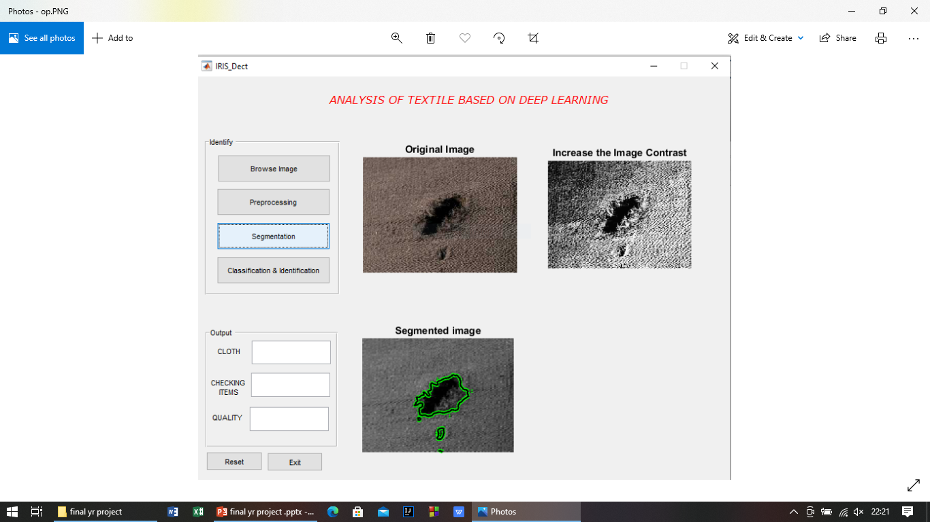
SCREENSHOTS

Slide 13
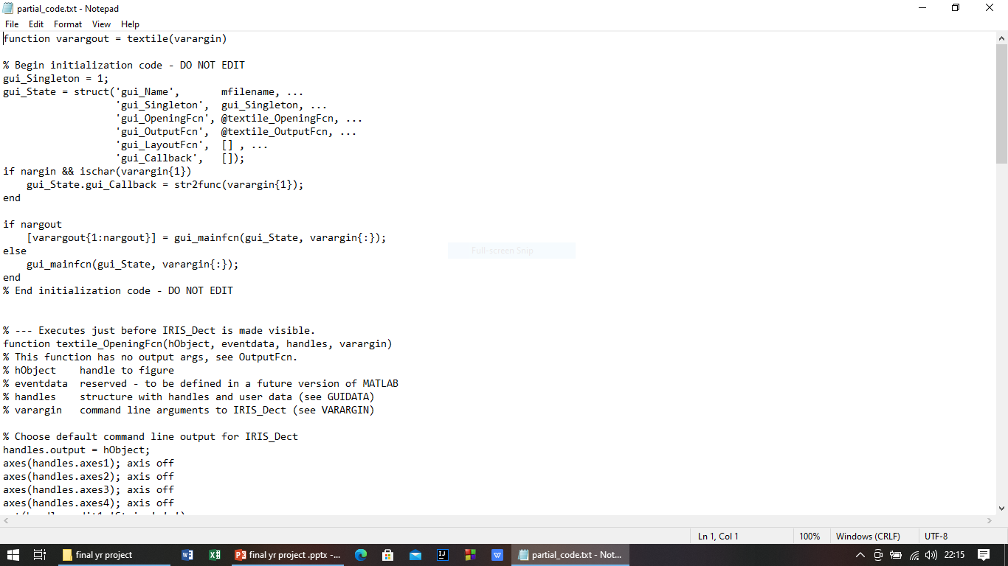

Slide 14
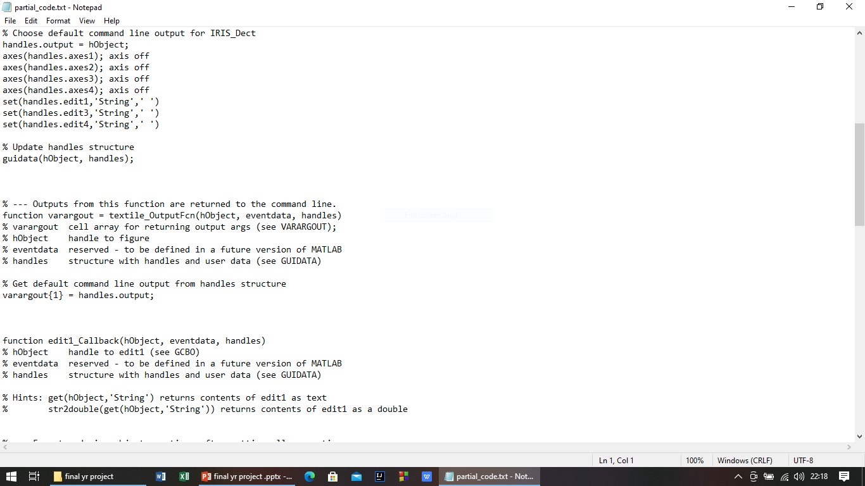

Slide 15
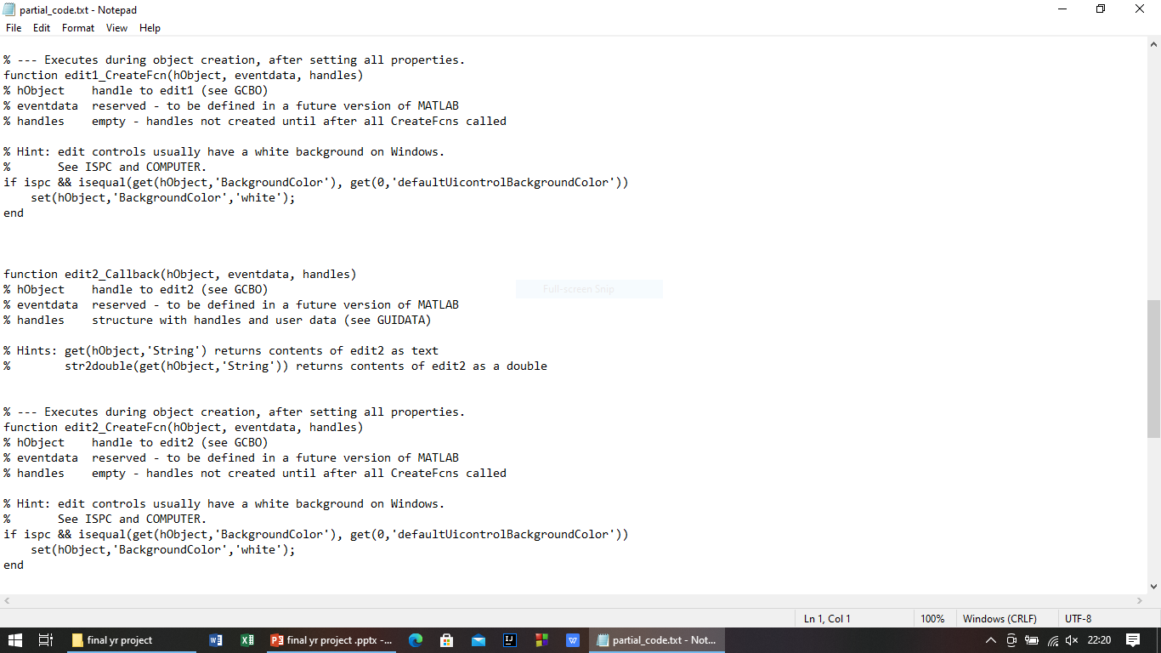

Slide 16
MODULES Module 1-Damage Detection Module 2- Quality check
Deep Learning Techniques Used
.
Preprocessing
Segmentation
Classification

Slide 17
SOFTWARE REQUIREMENTS
MATLAB 2016a(using MATLAB c)

Slide 18
SOFTWARE REQUIREMENTS
Mat lab 2016(A)
MATLAB is a scientific programming language and provides strong mathematical and numerical support for the implementation of advanced algorithms. It is for this reason that MATLAB is widely used by the image processing and computer vision community. New algorithms are very likely to be implemented first in MATLAB, indeed they may only be available in MATLAB.

Slide 19
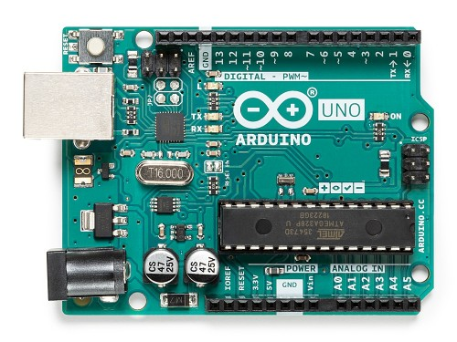
HARDWARE REQUIREMENTS
Arduino IDE
Proteus tool
GSM
Tag
Flux
LCD and Buzzer

Slide 20
EXISTING METHOD:
Support Vector Machines and Random Forests (RF) were success- fully used in Cloths segmentation.
The RF became very used due to its natural capability in handling multi-class problems and large feature vectors.
Manual process.
In accurate

Slide 21
PROPOSED SYSTEM:
In CNN algorithm is used in proposed method.
We are using GUI method
To identify Size, Dress quality, damaged cloths and suits of women and men.

Slide 22
ADVANTAGES
CNN easier to train
Less prone to overﬁtting
CNN is more efficient, as it can categorize each class with their own characteristics.

Slide 23
Proposed description
First a image selected for the processes listed below.
The selected image may have some noise so the image is filtered using median filter.
Then the shape of the Cloth will be segmented using ROI.
Features of the selected image will be extracted using haar wavelet transform (HWT) and histogram of oriented gradients (HOG).
The extracted features will be classified with training dataset using CNN
Finally the result will be displayed whether the lung image was quality,damaged and suits of dresses for women and men.

